Slide 1
ACTIVITIES NIGHT
Monday, October 2ND

Slide 2
Grab an application from Admin & Gather your TEAM.

Slide 3
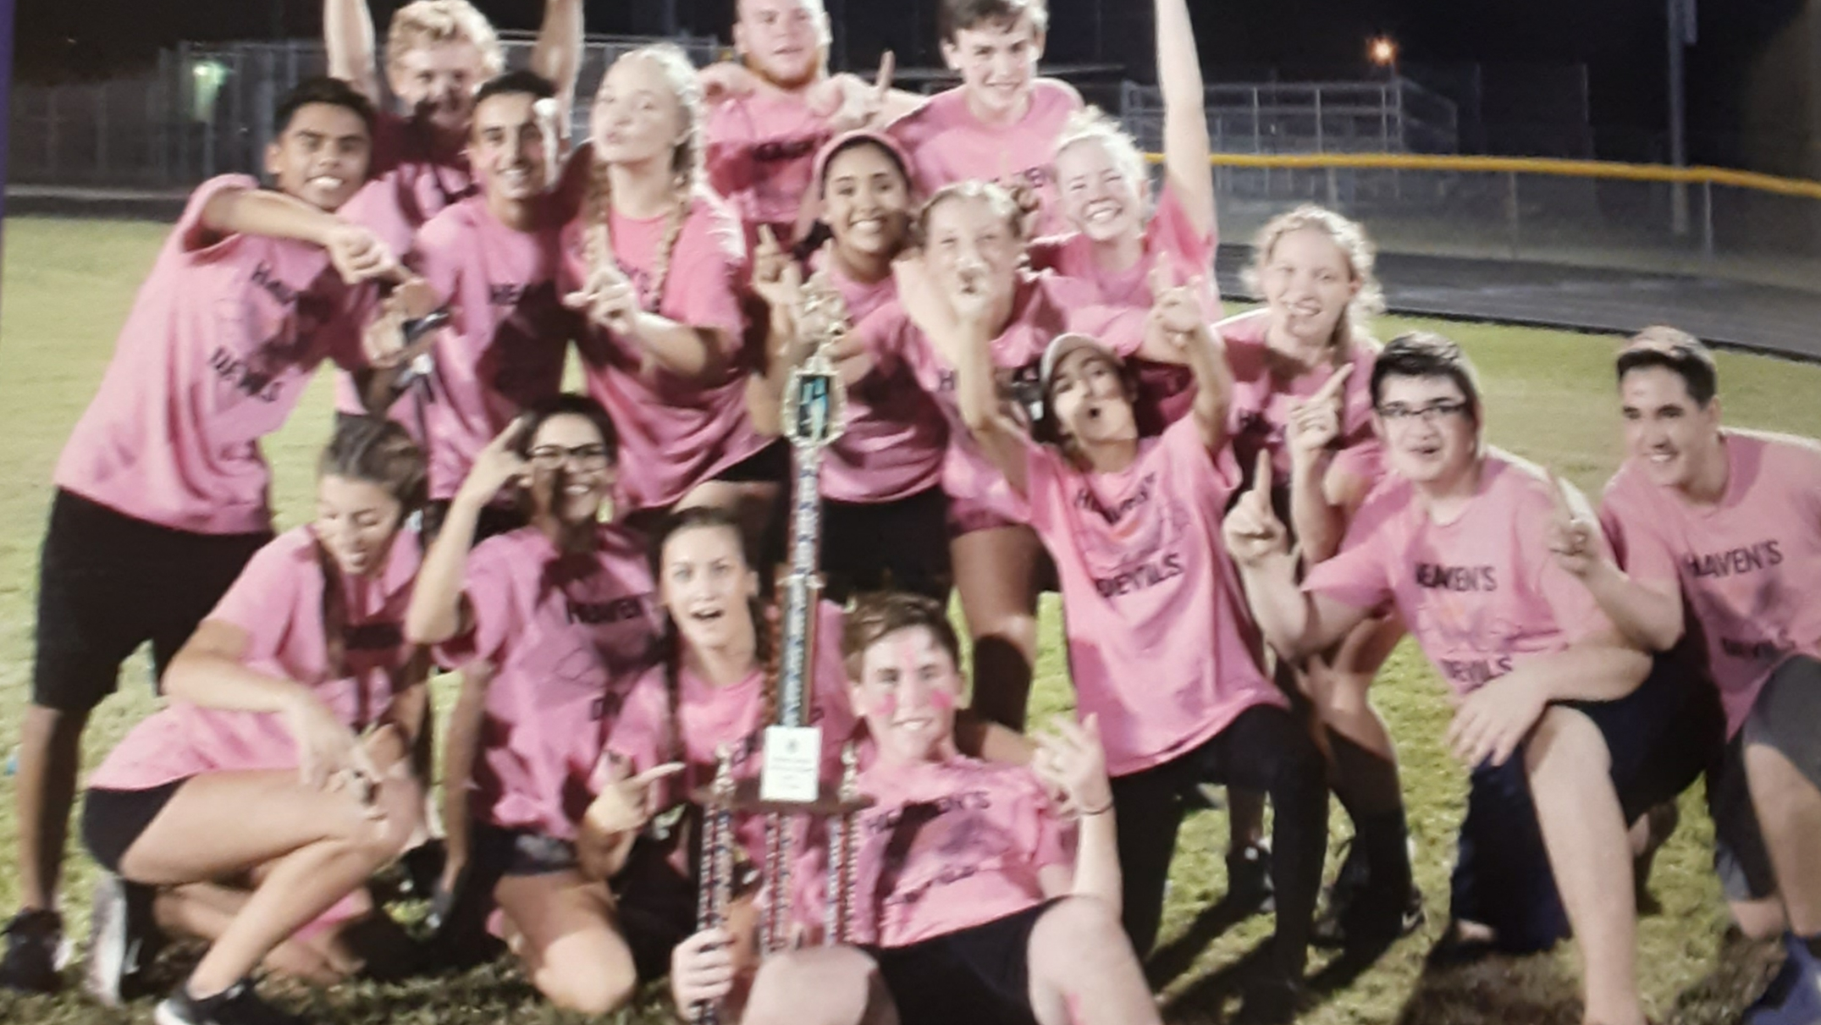
Find a Sponsor

Slide 4
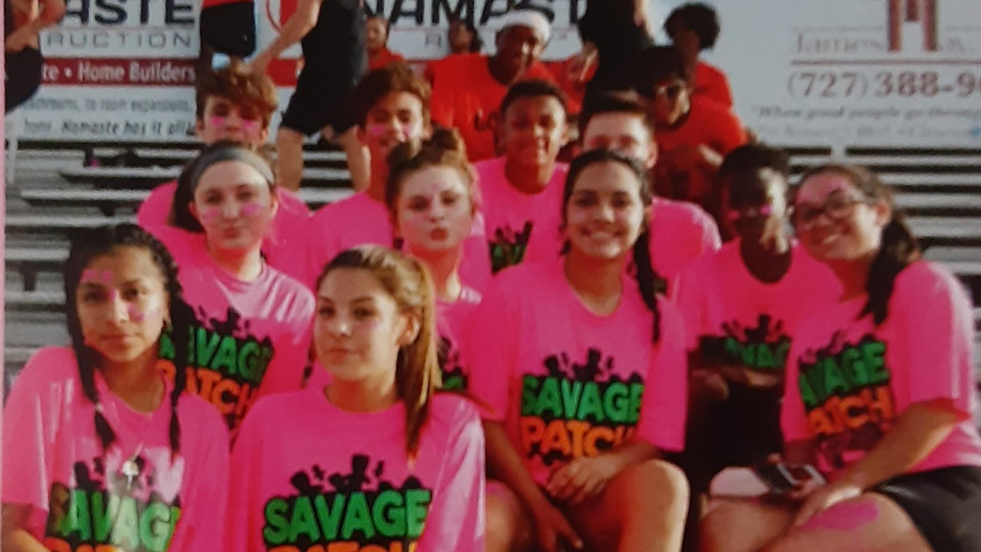
Name Your Team

Slide 5
Make Your Shirts

Slide 6
Create A TEAM POSTER

Slide 7
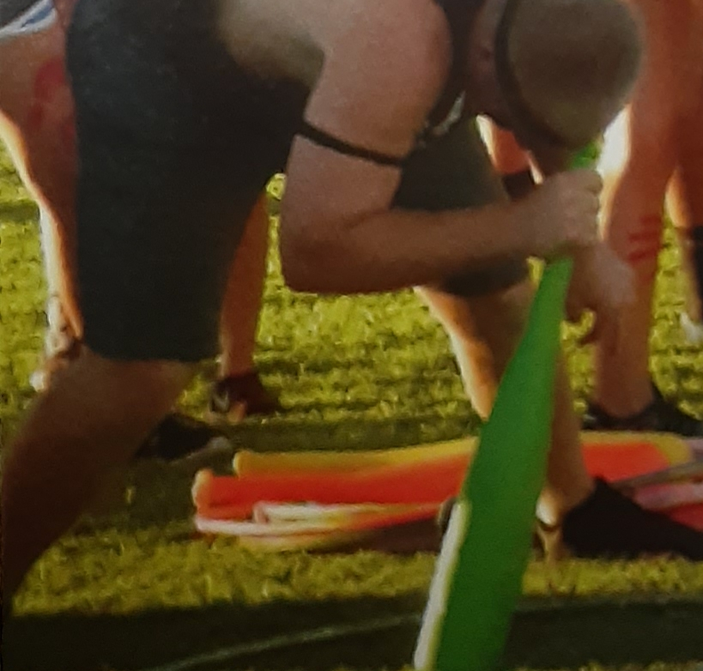
Make sure to send your Captain WITH your poster and $40.00 to the Team Meeting after school Thursday, October, 28th in A2 for a SUPER SHORT Meeting.

Slide 8
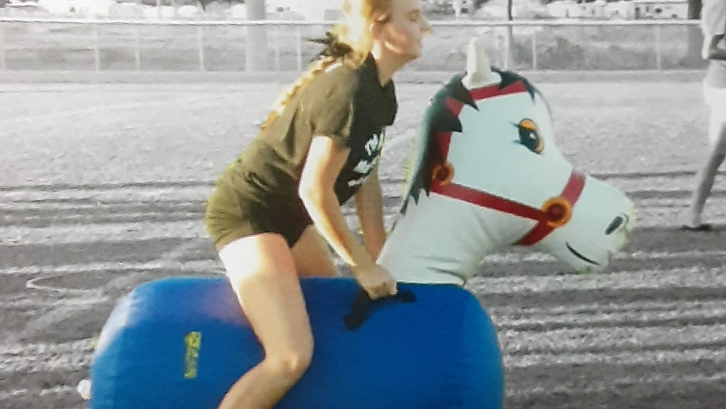
ARRIVE October 2nd 5pm READY FOR A GREAT TIME!

Slide 9
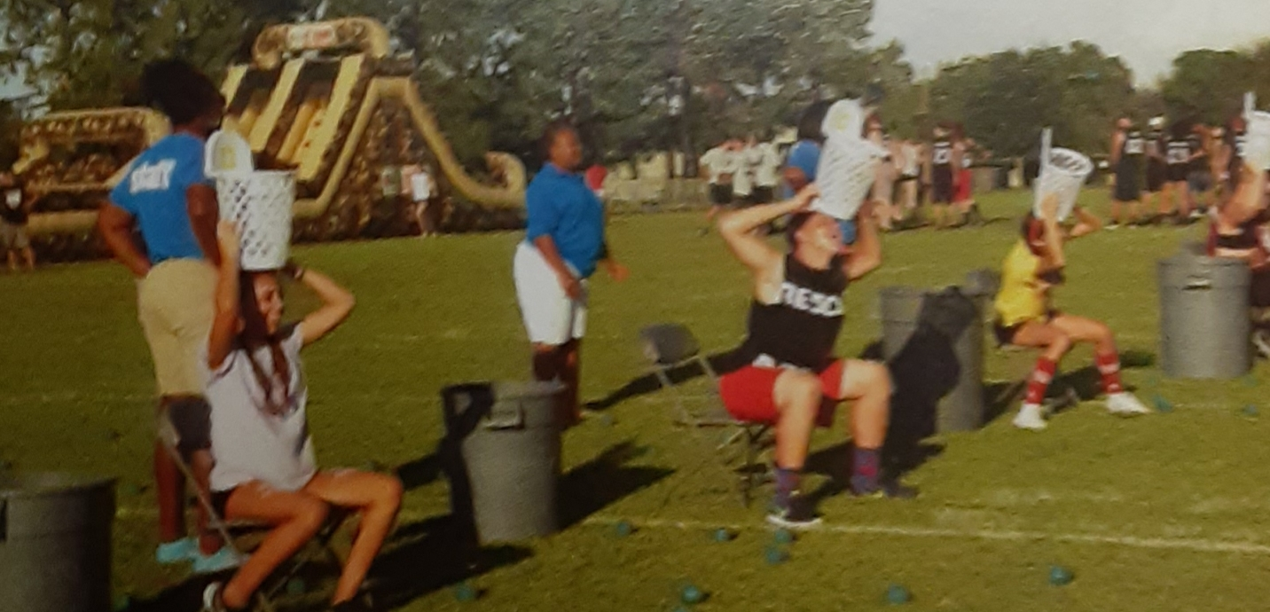

Slide 10
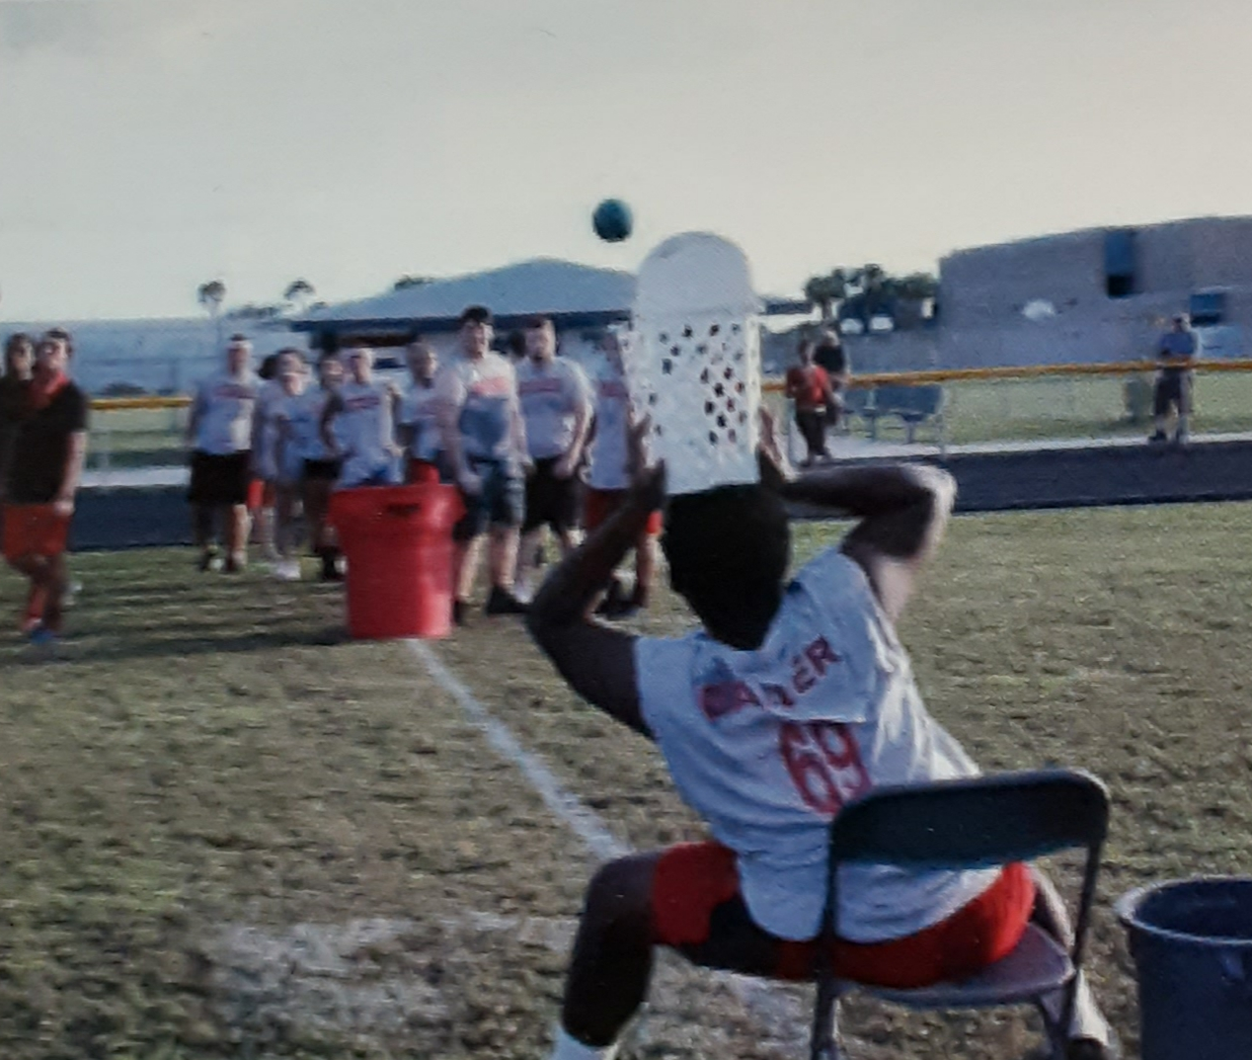
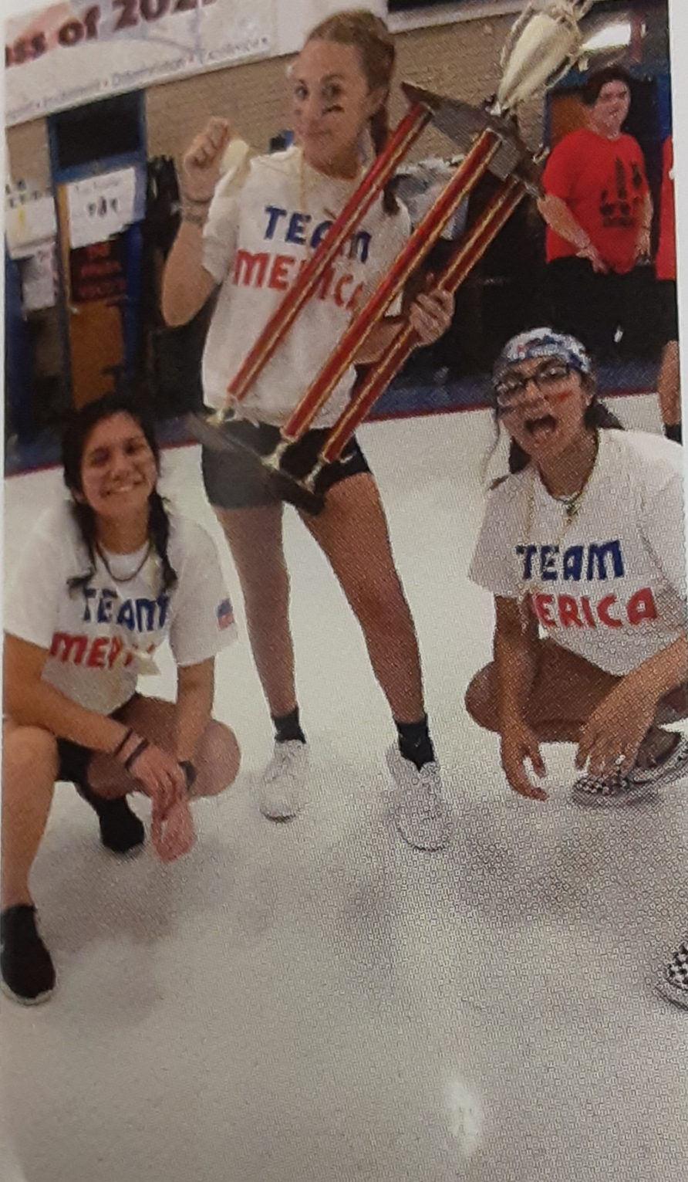
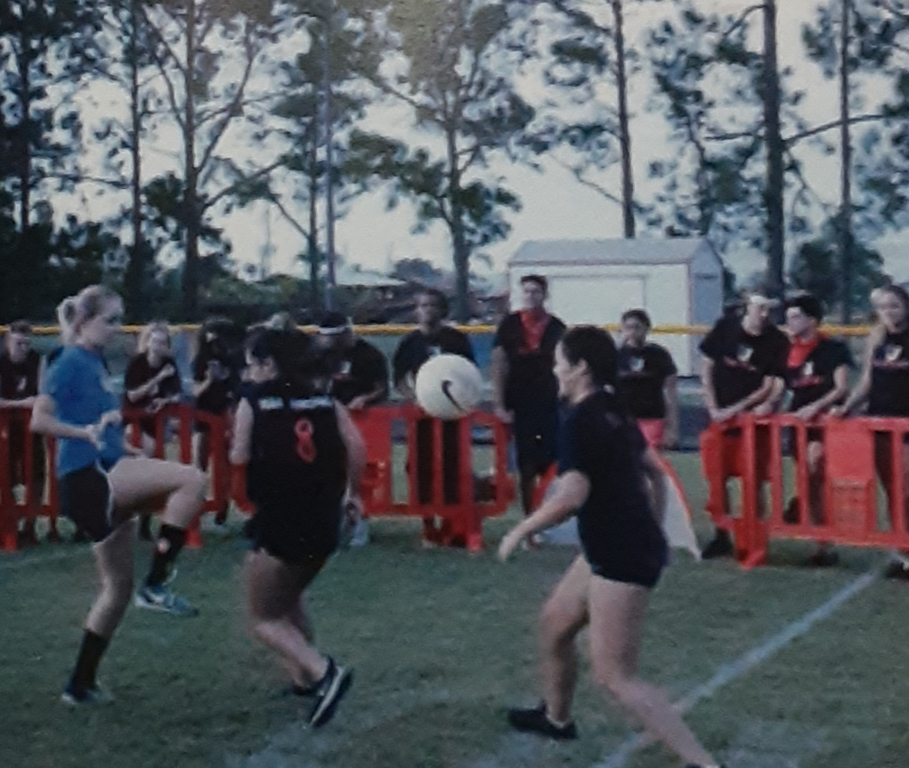
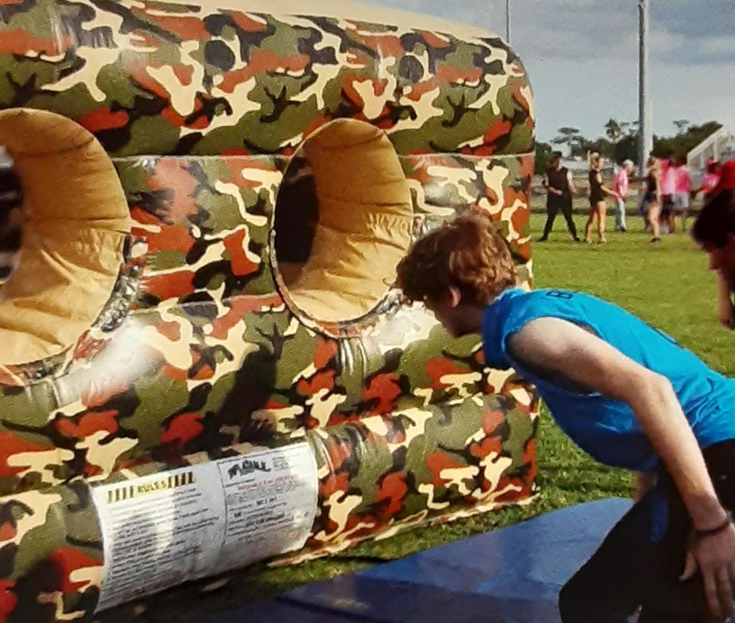

Slide 11
